Slide 1
Lesson Node js

Slide 2
Node.js Tutorials
Node.js is an open-source server side runtime environment built on Chrome's V8 JavaScript engine. It provides an event driven, non-blocking (asynchronous) I/O and cross-platform runtime environment for building highly scalable server-side applications using JavaScript.
Node.js tutorials will help you learn the essentials of Node.js starting from the basics to an advanced level. These tutorials are broken down into sections, where each section contains a number of related topics that are packed with easy to understand explanations, real-world examples, useful tips, informative notes, and "points to remember" section.

Slide 3
Prerequisites
Basic knowledge of HTML, JavaScript and web application is recommended.

Slide 4
What is Node.js?
Node.js is an open-source server side runtime environment built on Chrome's V8 JavaScript engine. It provides an event driven, non-blocking (asynchronous) I/O and cross-platform runtime environment for building highly scalable server-side application using JavaScript.
Node.js can be used to build different types of applications such as command line application, web application, real-time chat application, REST API server etc. However, it is mainly used to build network programs like web servers, similar to PHP, Java, or ASP.NET.

Slide 5
Continue
Node.js was written and introduced by Ryan Dahl in 2009. Visit Wikipedia to know the history of Node.js.
Node.js official web site: https://nodejs.org
Node.js on github: https://github.com/nodejs/node
Node.js community conference http://nodeconf.com

Slide 6
Continue
Advantages of Node.js:
Node.js is an open-source framework under MIT license. (MIT license is a free software license originating at the Massachusetts Institute of Technology (MIT).)
Uses JavaScript to build entire server side application.
Lightweight framework that includes bare minimum modules. Other modules can be included as per the need of an application.
Asynchronous by default. So it performs faster than other frameworks.
Cross-platform framework that runs on Windows, MAC or Linux

Slide 7
Node.js Basics
Node.js supports JavaScript. So, JavaScript syntax on Node.js is similar to the browser's JavaScript syntax.

Slide 8
Primitive Types:
Node.js includes following primitive types:
String
Number
Boolean
Undefined
Null
RegExp
Everything else is an object in Node.js.

Slide 9
Node.js Module:
Module in Node.js is a simple or complex functionality organized in single or multiple JavaScript files which can be reused throughout the Node.js application.
Each module in Node.js has its own context, so it cannot interfere with other modules or pollute global scope. Also, each module can be placed in a separate .js file under a separate folder.
Node.js implements CommonJS modules standard. CommonJS is a group of volunteers who define JavaScript standards for web server, desktop, and console application.

Slide 10
Module Types:
Node.js includes three types of modules:
Core Modules
Local Modules
Third Party Modules

Slide 11
Node.js Core Modules
Node.js is a light weight framework. The core modules include bare minimum functionalities of Node.js. These core modules are compiled into its binary distribution and load automatically when Node.js process starts. However, you need to import the core module first in order to use it in your application.

Slide 12
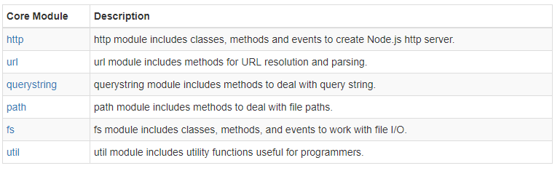
Continue
The following table lists some of the important core modules in Node.js.

Slide 13
Loading Core Modules
In order to use Node.js core or NPM modules, you first need to import it using require() function as shown below.
var module = require('module_name');
As per above syntax, specify the module name in the require() function. The require() function will return an object, function, property or any other JavaScript type, depending on what the specified module returns.

Slide 14
Continue
The following example demonstrates how to use Node.js http module to create a web server.
Example: Load and Use Core http Module
var http = require('http');
var server = http.createServer(function(req, res){
//write code here
});
server.listen(5000);

Slide 15
module.exports
In the previous section, you learned how to write a local module using module.exports. In this section, you will learn how to expose different types as a module using module.exports.
The module.exports or exports is a special object which is included in every JS file in the Node.js application by default. module is a variable that represents current module and exports is an object that will be exposed as a module. So, whatever you assign to module.exports or exports, will be exposed as a module.

Slide 16
Export Literals
Message.js:
module.exports = 'Hello world';
//
or exports = 'Hello world';
Now, import this message module and use it as shown below.
app.js
var msg = require('./Messages.js');
console.log(msg);

Slide 17
Node Package Manager
Node Package Manager (NPM) is a command line tool that installs, updates or uninstalls Node.js packages in your application. It is also an online repository for open-source Node.js packages. The node community around the world creates useful modules and publishes them as packages in this repository.
Official website: https://www.npmjs.com

Slide 18
Continue
NPM is included with Node.js installation. After you install Node.js, verify NPM installation by writing the following command in terminal or command prompt.
$ npm –v
$ npm install npm –g
$ npm help

Slide 19
Continue
Install Package Locally
$ npm install <package name>
$ npm install express
Add Dependency into package.json:
$ npm install express --save

Slide 20
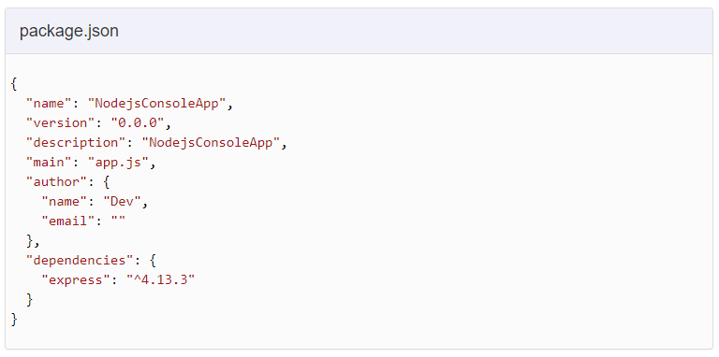

Slide 21
Install Package Globally
$ npm install -g express
Update Package
$ npm update <package name>
$ npm update express
Uninstall Package
$ npm uninstall <package name>
$ npm uninstall express

Slide 22
Node.js Web Server:
In this section, we will learn how to create a simple Node.js web server and handle HTTP requests.
To access web pages of any web application, you need a web server. The web server will handle all the http requests for the web application e.g IIS is a web server for ASP.NET web applications and Apache is a web server for PHP or Java web applications.
Node.js provides capabilities to create your own web server which will handle HTTP requests asynchronously. You can use IIS or Apache to run Node.js web application but it is recommended to use Node.js web server.

Slide 23
Create Node.js Web Server
Server.js
var http = require('http'); // 1 - Import Node.js core module
var server = http.createServer(function (req, res){ // 2 - creating server
//handle incomming requests here..
});
server.listen(5000); //3 - listen for any incoming requests
console.log('Node.js web server at port 5000 is running..')
$ npm node server.js

Slide 24
Frameworks for Node.js
You learned that we need to write lots of low level code ourselves to create a web application using Node.js in Node.js web server section.
There are various third party open-source frameworks available in Node Package Manager which makes Node.js application development faster and easy. You can choose an appropriate framework as per your application requirements.

Slide 25
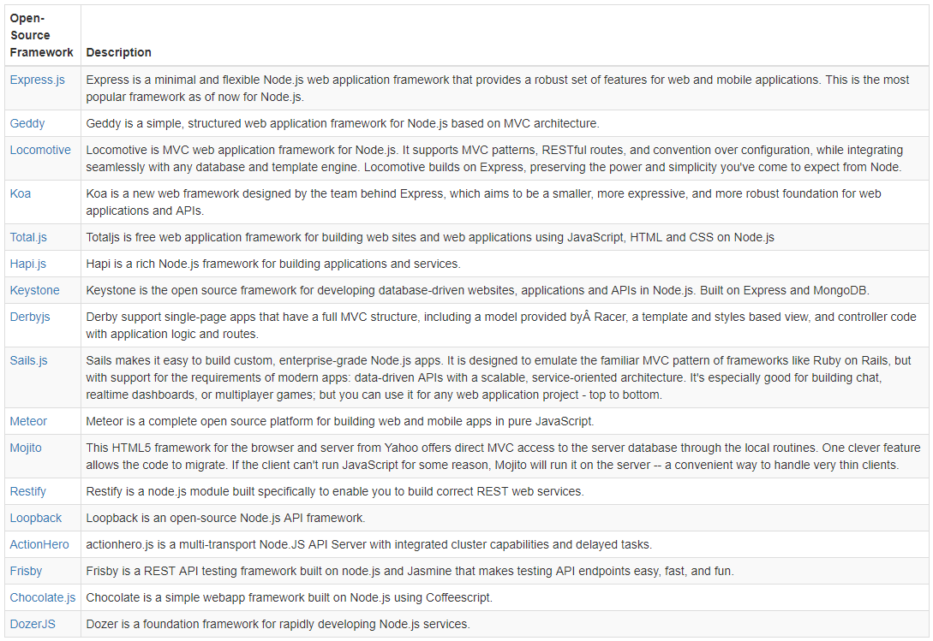
The following table lists frameworks for Node.js.

